Slide 1

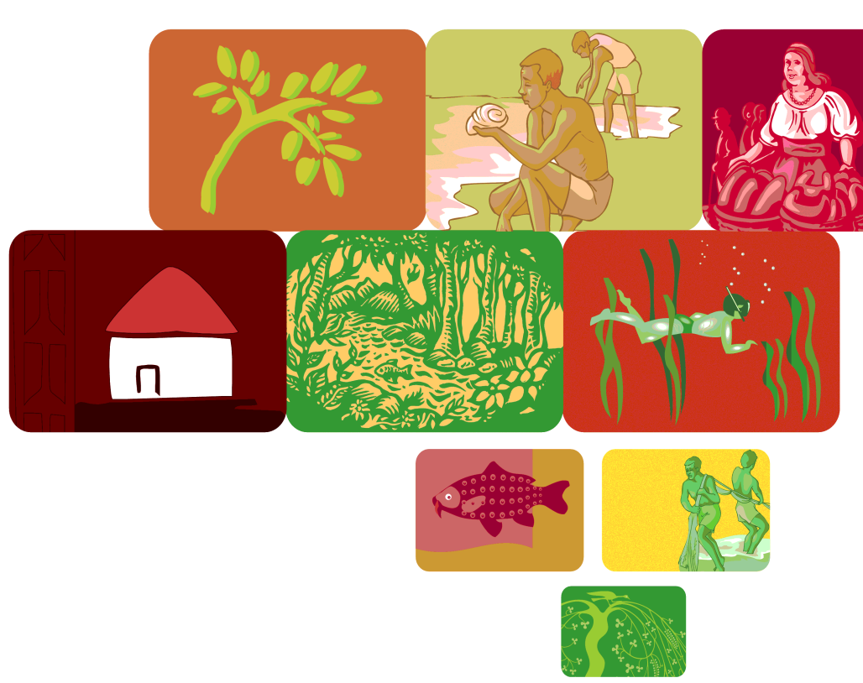
“The Green Economy and the Caribbean: Issues, Ideas and Initiatives”
Launch of the Caribbean Green Economy Action Learning Group
Nicole Leotaud
Caribbean Natural Resources Institute (CANARI)
Caribbean Environment Forum 6
St Kitts, May 2012

Slide 2


FOOD
Ecosystem collapse
ENERGY
WATER
CONFLICT
CLIMATE
ECONOMIC
Notes:
There are multiple crises facing the earth today in addition to the economic crises, and these have created an opportunity to rethink our model of economic development.

Slide 3
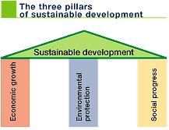
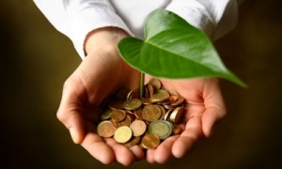
Notes:
Green economy directly addresses the Economic Growth pillar of sustainable development, and is thus an integral part of moving towards sustainable development.

Slide 4
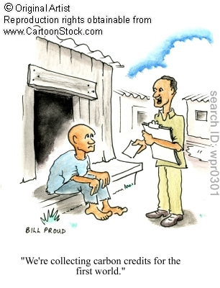
Risks
“Green” but what about people?
Green jobs for who?
Trade protection and exclusion from economic markets?
One size fits all?
Notes:
Some people are concerned about what “green economy” can mean.

Slide 5
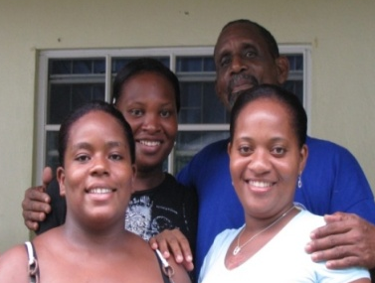
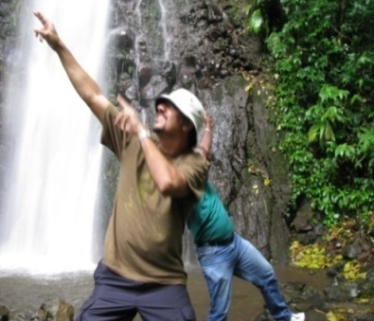
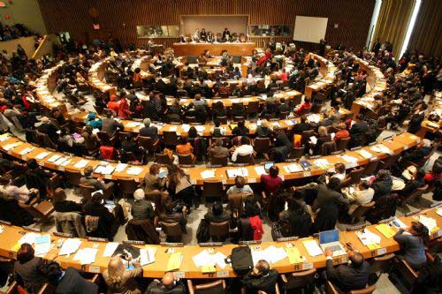
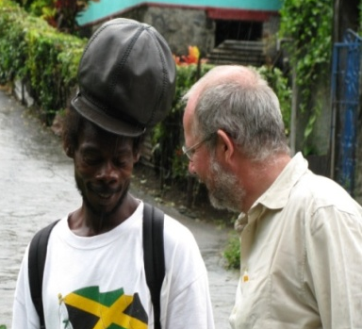
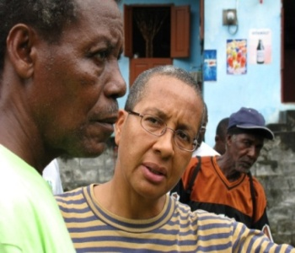
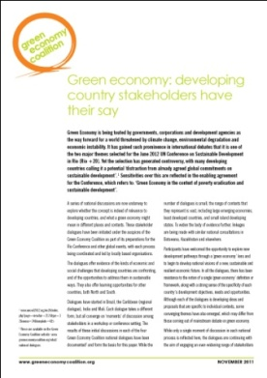

What does “Green Economy” mean in the Caribbean context?
How can we get out voice heard in international discussions?
Notes:
Voices of Caribbean people need to be heard in international discussions.
Involvement of CANARI in the Green Economy Coalition (GEC), via support from the International Institute for Environment and Development (IIED), brings Caribbean ideas to international fora. IIED and GEC developed a synthesis paper of views from various southern countries and the Caribbean.

Slide 6
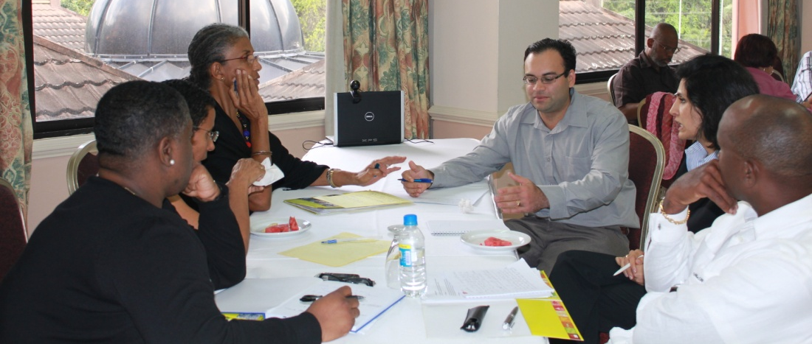
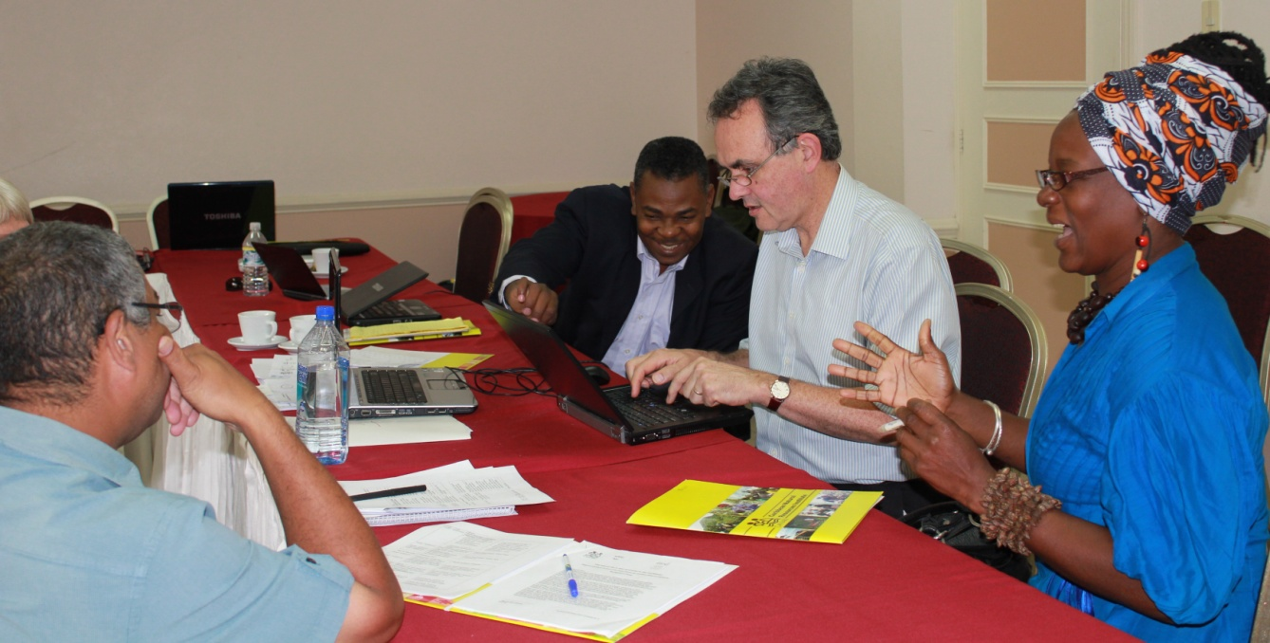
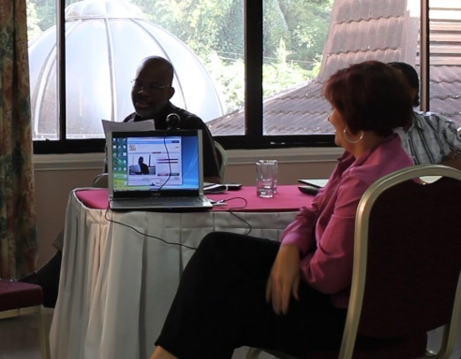
Caribbean regional dialogue
Notes:
A Caribbean regional dialogue process was facilitated by CANARI from December 2010 to March 2012. In February 2011, a regional workshop was held that brought diverse stakeholders (from government, civil society, community groups, private sector, and inter-governmental agencies) together in Trinidad to discuss what a green economy means in the Caribbean context. The report of the meeting, and the position paper that was distilled from this and other stakeholder input, is available on CANARI’s website.

Slide 7
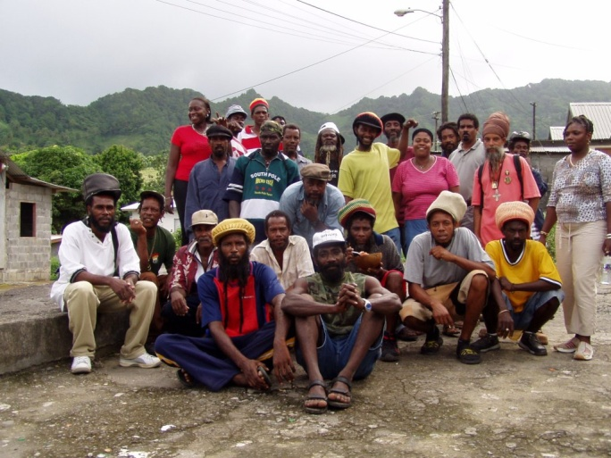
Characteristics of a green economy in the Caribbean
Equitable distribution of economic benefits and effective management of ecological resources
Economically viable and resilient to both external and internal shocks
Self-directed and self-reliant
Pro-poor and generating decent jobs and working conditions for local people
Notes:
Other characteristics include:
Industries optimize the relationship between demand and domestically produced supply.
Best practices are rewarded and bad practices discouraged.
Businesses apply “triple bottom line” principles to produce net flows of economic, social and environmental benefits.
The needs and constraints of specific groups, such as female heads of households, are addressed in labour and welfare policies and practices.
Educational systems offer young people knowledge, disciplines and skills that are relevant to their lives and potential career opportunities.
Dependency on imported or high carbon sources of energy is reduced and eliminated where feasible.
Available natural, human, and physical resources are used efficiently based on realistic assessment and optimal deployment.
Positive and mutually reinforcing rural-urban and other inter-sectoral economic linkages are created.

Slide 8
Key principles for a green economy in the Caribbean
Common vision
Human security
Good governance
Well educated citizenry
Involved young people
Informed and mobilised civil society
Commitment to pan-Caribbean cooperation

Slide 9
EMERGING CARIBBEAN INITIATIVES:
“We wish to thank the world for giving our model of development a name.”
Notes:
Even though the concept of what is a “green economy” is still being discussed, there are several emerging and ongoing initiatives in the Caribbean that reflect the characteristics and principles discussed.

Slide 10
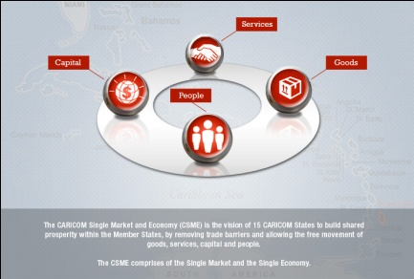
Regional policy, institutions and initiatives
CARICOM Single Market Policy Framework
CARICOM Regional Framework and Implementation Plan for development that is resilient to climate change
Caribbean Sea Commission
Sectoral e.g. CARICOM Common Fisheries Policy
CARILED CIDA funded project on local economic development in CARICOM countries
UNEP green economy programme for the Caribbean

Slide 11

National policy initiatives
Barbados Green Economy Policy Framework
Guyana Low-Carbon Development Strategy
Dominica Organic Development Policy Framework and low carbon climate resilient development strategy
Saint Lucia developing a national vision
Grenada Alternative Growth and Poverty Reduction Strategy
Dominican Republic Climate Compatible Development Strategy
British Virgin Islands environmental mainstreaming
Trinidad and Tobago valuation of ecosystem services into national accounting

Slide 12
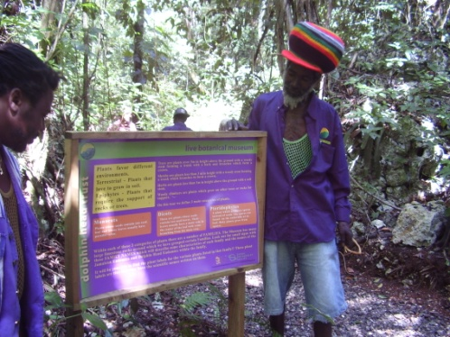
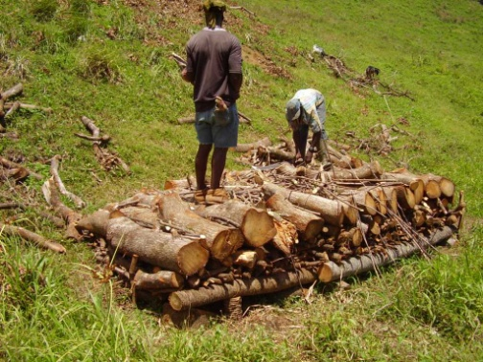
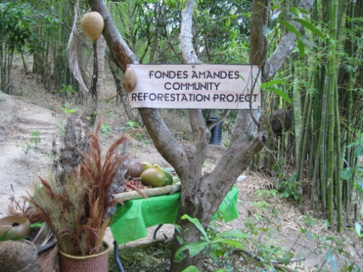
Sectoral initiatives
Sustainable rural livelihoods based on the use of natural resources
Greening urban development: Caribbean Network for Urban Land Management (CNULM)
Greening private sector: Suriname, Trinidad and Tobago Manufacturers Association, Green Business Barbados
Renewable energy: Solar, wind, geothermal
Organic agriculture
Sustainable tourism, community-based tourism, natural and cultural heritage tourism

Slide 13

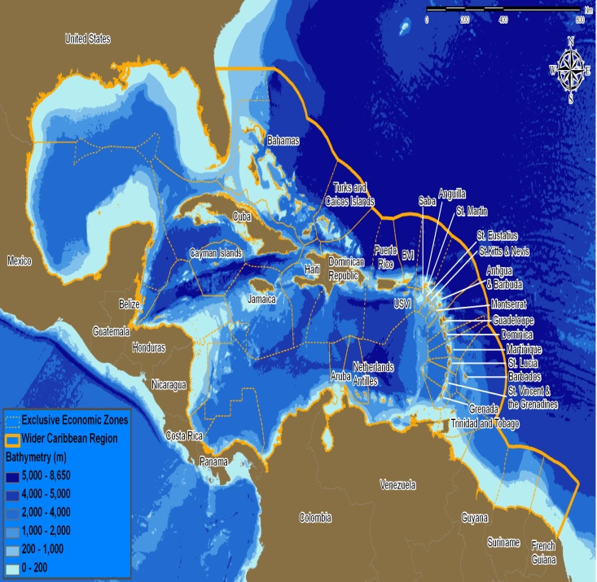
Notes:
There is a great need to facilitate sharing of ideas and information and collaboration on testing green economy approaches across the Caribbean.

Slide 14
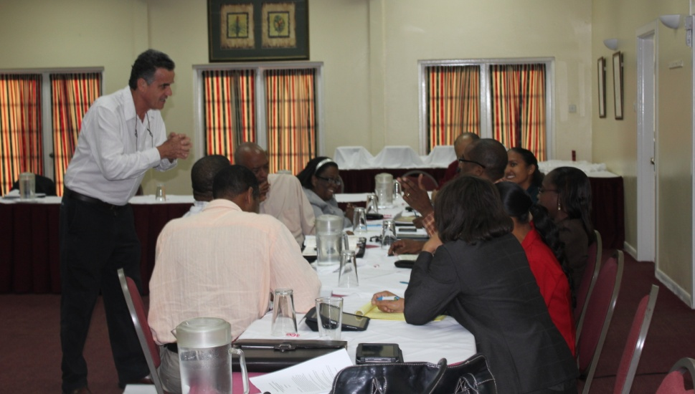
The Caribbean Green Economy Action Learning Group
Purpose: To identify and promote ways in which “green economy” can advance sustainable development in the Caribbean through shaping visions, perspectives, positions and actions. This will require examining:
  What are the opportunities?
  What are the potential threats?
  What could be a Caribbean vision of economic development?
Notes:
CANARI will coordinate a Caribbean Green Economy Action Learning Group to help facilitate sharing and collaboration across the Caribbean on green economy ideas and initiatives.

Slide 15




Objectives
1. Fleshing out the vision: building and sharing evidence-based knowledge
2. Promoting the vision: communication to influence policy and build commitment
3. Putting the vision into action: action research carried out by ALG members and their partners
4. Creating capacity to achieve the vision: capacity building for ALG members

Slide 16
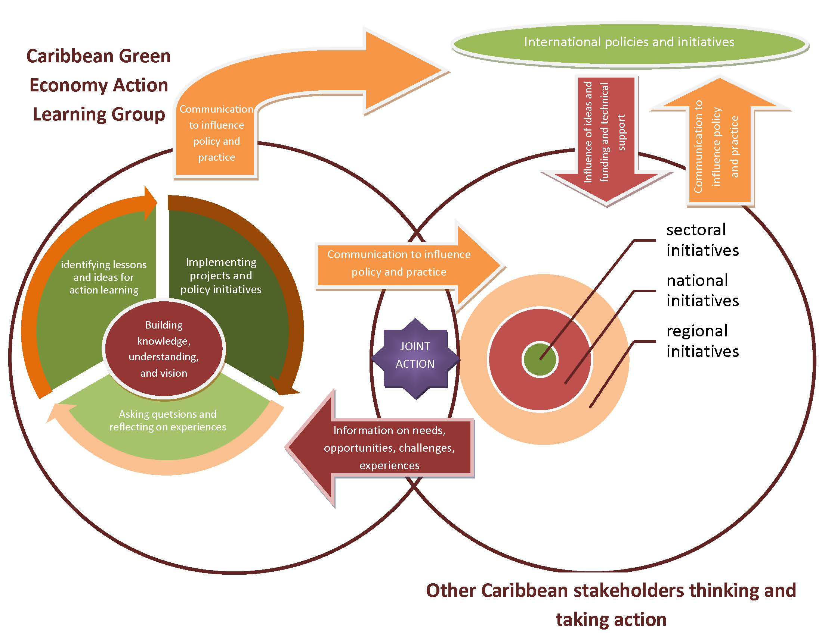
Notes:
The graphic shows a conceptual model of how the Caribbean Green Economy Action Learning Group (GE ALG) will work:
The right circle shows that Caribbean stakeholders are thinking and taking action on green economy at sectoral, national and regional levels.
Caribbean stakeholders are influenced via ideas and support coming from international policies and processes, shown in the red down arrow.
The red left arrow feeding into the GE ALG shows that information on needs, opportunities, challenges and experiences of other stakeholders is fed into this process.
The left circle that is the GE ALG involved internally in the action learning cycle to reflect on and analyse information and identify lessons and recommendations for policy and practice.
The action learning process produces knowledge that is communicated back to Caribbean stakeholders via the orange right arrow.
The GE ALG will communicate this knowledge directly to influence international policy and processes via the orange up and right arrow.
At the same time, Caribbean stakeholders can use this, and their own knowledge, to communicate to influence international policy and processes via the orange up arrow.
GE ALG members can take joint action in collaboration with other Caribbean stakeholders to test green economy approaches in the Caribbean, reflected in the purple star at the overlap of these two groups.

Slide 17
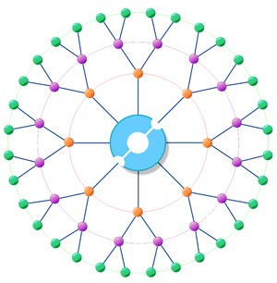
Networks of GE ALG members
GE ALG members
GE ALG Steering Committee
Notes:
Graphic shows that the Caribbean Green Economy Action Learning Group (GE ALG) is a core group of people, who will share ideas and collaborate on GE initiatives with their wider network, who will in turn influence ever widening networks to engage people across a wide variety of sectors and countries in the Caribbean.

Slide 18
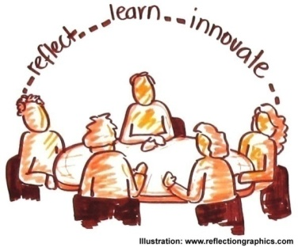



Identify a problem, need, challenge, or issue
Form a team
Commit to learning by doing
Research current knowledge / learn from experience
Engage in a processes of reflective questioning
Develop an action plan for testing an improved approach
Pilot / trial / test the strategies
Evaluate and reflect to create learning opportunities
Action learning cycle

Slide 19
What do you think?
...are the questions?
...are the priority areas for action?
...are the opportunities?

