Slide 1
Building capacity to facilitate stakeholder participation in forest management in the Caribbean islands
This presentation was produced by the Caribbean Natural Resources Institute as an output of the project " Regional knowledge sharing initiative on improved governance and influencing policy for community forestry and sustainable forest-based livelihoods" funded by the United Nations Food and Agriculture Organization under its Forest Law Enforcement, Governance and Trade Support Programme for African, Caribbean and Pacific Countries (ACP-FLEGT Programme) for forest managers to present to policy makers.

Slide 2
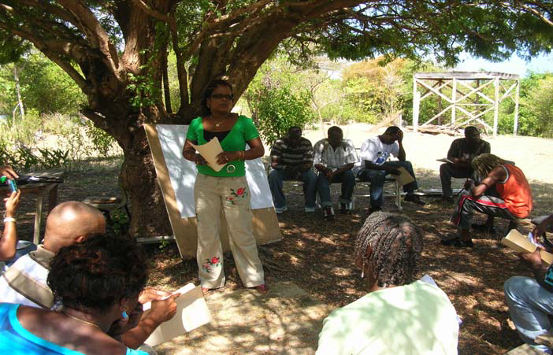
Content
What do we mean by facilitating participatory forest management (PFM)?
The concept of PFM
Benefits of PFM
Challenges to doing PFM
Summary
What can you do?
Questions
Stakeholders in Saint Lucia discussing approaches to PFM

Slide 3
What do we mean by facilitating PFM?
PFM is structured collaboration among stakeholders in which they influence and share control over decisions which determine how forest resources are conserved, accessed, used, transformed and marketed.
Facilitation is the process of helping groups or individuals come to a common objective without imposing or dictating an outcome

Slide 4
Process of facilitating PFM
Stakeholder identification and analysis
Mobilising stakeholders
Facilitate discussions
Develop consensus on decisions
Validate consensus
Evaluate results and lessons
Notes:
STAKEHOLDER IDENTFICATION AND ANALYSIS: A stakeholder can be defined as the people who have rights to, responsibilities for, and interests in a resource.
Typical stakeholders in natural resource management therefore include government agencies, the private sector, CBOs, NGOs, academic institutions, the media, intergovernmental bodies, technical assistance agencies and donors;
Stakeholders are found at many levels:
local (e.g. communities living adjacent to a forest, forest users);
national (e.g. government agencies with responsibility for forest management, private sector companies)
regional (e.g. regional NGOs, regional intergovernmental bodies)
international (e.g. tourists, foreign-based companies, international NGOs, regional or international donors and technical assistance agencies);
organisations or formal groups as well as individuals, communities and informal networks;
people with legal rights, responsibilities and interests as well as people undertaking illegal activities (e.g. illegal hunting, illegal occupation of land); and
people directly using or managing a resource as well as people who have an indirect impact on a resource, for example, people benefiting from the ecological services (e.g. watershed functions) or people whose activities have an impact on the ecosystem (e.g. residents in an upper watershed impact on coastal and marine ecosystems downstream).
Stakeholder identification is identifying who should be involved. It is important to focus on identifying both the less powerful stakeholders, who may otherwise be marginalised in the process, as well as the most powerful stakeholders who may not feel a need to engage in the participatory process if they feel they can influence high-level decision-makers directly.
An effective stakeholder identification process helps resource managers to:
understand the different ways in which people interact with the natural resources and the management regime;
identify the stakeholders that are key to successful implementation of management strategies; and
identify areas of potential conflict.
Stakeholder analysis is analysing their interests. By understanding stakeholders’ rights, responsibilities, interests,
perspectives, and power relationships and, which are the key stakeholders, you can better facilitate their involvement in a participatory process.
This will help in identifying how they should be engaged in management, what are the potential areas of conflict, and the capacities and capacity gaps that might support or hinder resource management.
MOBILISING STAKEHOLDERS:
Mobilisation is to assure that all potential participants in the process are informed of what is happening, are aware of the factors that prompted the process, recognise the legitimacy of the people and organisations that have taken the initiative, and are encouraged to become involved.
Involves actions such as:
Identifying the target audience
Choosing a desired mix of stakeholders for the activity and selecting the date, time and venue and
Developing a mobilisation strategy to identify communication products and pathways best suited to the specific audiences.
FACILITATE DISCUSSIONS:
This is a process of helping groups or individuals come to a common objective without imposing, dictating or manipulating an outcome.
Facilitation involves using a range of tools and methods to draw out information or ideas from the participants in the process. The facilitator guides the discussion towards some predetermined objective, for example an agreed way forward to resolve a management issue.
Facilitation is very different from teaching and training where there is a much higher flow of information from the teacher or trainer to the participants. In a facilitated process information is flowing from the participants. There is a high level of involvement of and interaction among participants. The facilitator asks questions and helps to clarify points. The facilitator does not control the decisions made by participants or the results of the process.
The keys to good facilitation are providing conditions in which stakeholders are comfortable to state their opinions and air their concerns; listening carefully to what is being said; synthesizing the information; and communicating it back in ways that lead the group towards decisions and agreements.
DEVELOP AND VALIDATE A CONSENSUS:
A well facilitated discussion leads to consensus however, it is important to review the decision/agreements with the participants and verify that what is documented is what they want said.
EVALUATE RESULTS AND LESSONS:
At the end of PFM, the objective of the process should be reviewed to see if it was achieved as well as if the facilitation effectively and
equitably engaged all participants. This analysis should be documented lessons learnt communicated for future facilitation.

Slide 5
Benefits of PFM
Contributes to building consensus on controversial issues
Identifies opportunities to enhance livelihoods
Builds the capacity of stakeholders
Gives voice to stakeholders
Promotes awareness on forest management issues
Notes:
Contributes to building consensus on controversial issues
During 2007 to 2010, the Government of Trinidad and Tobago contracted CANARI as an independent facilitator in the participatory development of a national forest policy and a protected areas policy. During the initial stages of development of these policies, six controversial issues were identified. CANARI drafted one page summaries of each of the issues and included 2-3 questions on each sheet to encourage analysis and negotiation. These sheets were used to generate recommendations in facilitated focus group discussions which were further refined in separate meetings with key stakeholders. The end result was a high level of consensus on some very challenging issues for forest management.
Identifies opportunities to enhance livelihoods
The islands of St. Vincent and the Grenadines experienced wide scale flooding and land slippage after intense rains in April 2011. The Orange Hill Development Organization had been managing two small projects geared at improving livelihoods but because of the flooding challenge, funding for forest-based livelihood projects was redirected. Forest managers facilitated a session with members of the CBO which identified strategies for improving or maintaining their forest-based livelihoods during the period of recovery when external support was suspended.
Builds the capacity of stakeholders
The Co-operative Development Division Office of the Government of Dominica, the Dominica Beekeepers Co-operative Society Ltd. (DBCS) and the Pure Blossom Co-operative Society Ltd. (PBCS) facilitated a session to build the capacity of DBCS for PFM. One of the key outcomes was that participants felt that they were now more aware of the rights, roles and responsibilities of key stakeholders which would help them to make better decisions about the design and implementation of projects to improve forest-based livelihoods.
Gives voice to stakeholders
During the establishment of a Local Forest Management Committee (LFMC) in the Morant Riverside Watershed Management Unit, Jamaica, forest managers facilitated a session with stakeholders from surrounding villages who are implementing projects geared to improving livelihoods. Participants reported that the sessions highlighted the importance of the groups meeting regularly to coordinate activities and assisted them in projecting a clear voice to the government on how forest resources should be managed to support sustainable forest-based livelihoods.
Promotes awareness on forest management issues
Forest officers from Saint Lucia’s Forestry Department facilitated sessions to guide the establishment of a management committee for the Millet Bird Sanctuary and Nature Trail. Two years had passed since the formulation of a management plan for the area and the representatives of key organisations had changed. The new representatives were not familiar with the project and found the sessions were useful in describing the situation on the ground and in helping them to gain a better understanding of the context in which the sanctuary is to be managed.

Slide 6
Challenges with PFM:
Capacity to facilitate
Capacity to facilitate
    Key capacities of a facilitator
      Neutral perspective
      World view and philosophy
      Culture and focus that are process-oriented
      Responsive and able to adapt
      Advanced skills
      Knowledge
Notes:
Key capacities for a facilitator of participatory processes include:
having, or being perceived to have, a neutral perspective so that all views can be equitably considered and that negotiation among different interests can be achieved;
having a world view and philosophy that places people at the heart of development, and respects and values the contributions of all people;
possessing a culture and focus that are process-oriented and not solely interested in the results of the process;
being responsive and able to adapt the process to respond to emerging needs and interests;
having advanced skills in communication (particularly listening skills), negotiation and conflict management;
having knowledge about the theory and practice of participatory planning and management, with relevant examples of real life application;
knowledgeable bout the local context, including an understanding of the natural ecosystems, management systems, legal and policy framework, and the stakeholders.

Slide 7
Challenges with PFM:
Capacity to facilitate
Capacity to participate
    World view / philosophy
    Culture
    Structure
    Adaptive culture and strategies
    Linkages
    Skills, knowledge, abilities
    Material resources
Time
Notes:
Capacity to participate
Effective participation requires that all stakeholders involved have the capacity to participate. Organisations as well as individuals need the capacity to participate. Capacity encompasses a range of elements (world view/philosophy, culture, structure, adaptive culture and strategies, linkages, skills, knowledge and abilities and material resources) and need to be considered collectively.
World view / philosophy
A coherent philosophy must exist with values, attitudes, principles and beliefs of respect and value for all people and the contribution that they can make. There must be trust and openness to allow other people to play an equitable role in decision-making. This vision must place people at the centre of development and address issues of equity and sustainability.
This is the foundation for participatory approaches. This philosophy may or may not be expressed in a formal (written) policy but it should at least be informally accepted and able to be applied in practice. Development of a shared vision among stakeholders is an extremely important element of a participatory approach.
Culture
There must be a willingness to work with other stakeholders towards shared objectives and a belief that this can be effective. This is expressed through procedures and processes guiding how the organisation does things.
A culture supporting participation may be especially difficult to achieve in organisations or institutions with a tradition of top-down central-control decision-making.
Structure
Structures need to be in place to facilitate open and clear communications internally and with partners. Communication channels must exist to receive input, share information, and facilitate discussion, debate and negotiation. Structures must have a clear definition of roles, functions, lines of communication and mechanisms for accountability.
Formal (e.g. multi-stakeholder committees) or informal (e.g. working groups) structures may be set up that reflect power relations and actually marginalise some stakeholders, for example those who are not members of formal groups or are illegal or informal resource users. Mechanisms will be needed to engage stakeholders who are marginalised by these structures.
Adaptive culture and strategies
The importance of continuous adaptive management as a result of active learning must be recognised. Practices and policies are required so that structures and mechanisms can be adapted to respond to changes in the natural resource being managed, the patterns of use of this resource, and the needs, interests, roles and responsibilities of all of the stakeholders involved.
Focusing on the process in participatory approaches means constant readjustment in response to the changing situation. For example, structures that are too rigid and closed may fail to engage emerging stakeholders or new priorities. Mechanisms need to be developed to capture needs and contributions of stakeholders on an ongoing and not just on a one-off basis. The design of projects with emphasis on often pre-determined fixed activities, deliverables, timeframe and budget challenges negatively effect participatory approaches.
Linkages
An ability to develop and manage relationships with individuals, groups and organisations is needed. Multi-disciplinary and inter-sectoral approaches must bring together government agencies, academia, private sector, NGOs, CBOs, communities and individuals.
Government agencies and other organisations with a focused mandate often find it difficult to work across sectors and disciplines. Cultural differences between types of organisations (for example between government agencies and the private sector) or between sectors (for example between the natural and social sciences) also make relationship-building difficult. The building of social or political power by civil society organisations is often a critical strategy in supporting their equitable and effective participation in decision-making.
Skills, knowledge, abilities (competencies)
Technical skills and knowledge in the specific management area is required. This may include for example knowledge about the ecosystem, management issues, management approaches (e.g. protected area, sustainable extraction) and implications (social, economic, etc.). Skills might include for example research, map reading, data interpretation and analysis, use of technology, etc.
Government agencies and academia often have very high technical competencies but may require capacity building in other areas for example in communication, stakeholder mobilisation, negotiation and conflict resolution skills. While some civil society organisations and communities may have strong technical competencies, including traditional knowledge, often this must first be built before they can be effectively engaged. Levelling the playing field so that all stakeholders have the required competencies to contribute is essential to the participatory process.
Skills and knowledge in how to effectively facilitate or engage in participatory processes is also needed. Examples include communication and interpersonal skills, ability to negotiate, ability to speak clearly and communicate effectively in front of a large group.
Material resources
Technology, equipment, materials and finance must be in place to support the effective implementation of the participatory process. There must be flexibility in allocation of these resources to respond to changing needs. Equitable allocation to stakeholders is also important.
Financial compensation must be given to stakeholders who sacrifice income generating opportunities in order to participate in processes. Asking someone to give up a day’s work and wages to attend a workshop without appropriate compensation is not equitable. Expenses need to be covered for all stakeholders, including civil society and communities.
Time
Participatory processes require identification and mobilisation of stakeholders, communication among them, and often debate and negotiation (and sometimes conflict management) before a decision can be reached by consensus. This is an iterative process and demands adequate time to facilitate stakeholder engagement and to enable adaptation to the changing situation. Limited time can correspondingly limit the effectiveness or depth of participation.

Slide 8
Summary
Participatory forest management increases and sustains benefits to stakeholders.
Forest managers in the Caribbean need to have the capacity to facilitate participatory processes for effective management of forest goods and services to ensure that the resources are conserved and people benefit

Slide 9
What can you do?
Advocate for and support PFM approaches that ensure that stakeholders equitably share control over decisions which manage forest goods and services.
Insist on having independent and skilled facilitators when engaging in participatory processes.

Slide 10
What can you do?
Support capacity building (training, exchange visits, action research and learning projects) of forest managers for facilitating participatory forest management.
Support and pilot the development and implementation of projects, plans, policies, and legislation to create the enabling environment for facilitation of PFM.

Slide 11
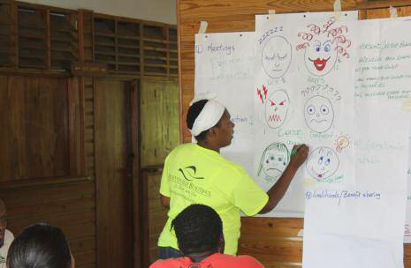
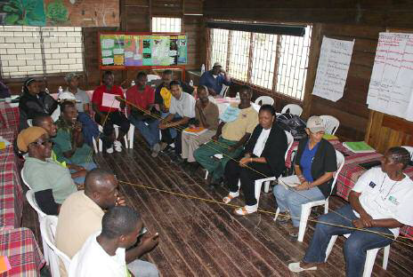
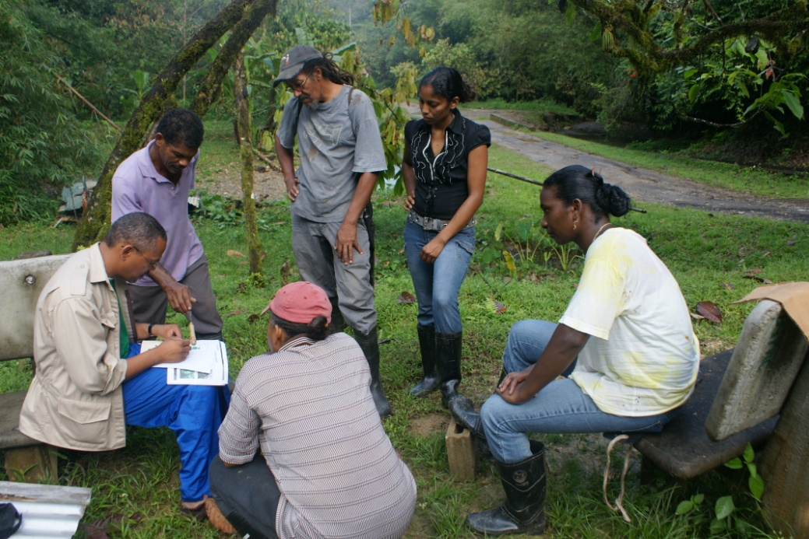
Any questions ??

Slide 12
Thank you.
For further information contact:
Caribbean Natural Resources Institute (CANARI)
Building 7, Fernandes Business Centre
Eastern Main Road, Laventille
Republic of Trinidad and Tobago
Tel: +1 868 626-6062
Fax: +1 868 626-1788
e-mail: info@canari.org
Website: http://www.canari.org
Presenter
Job title
Organization
# Street Address
Village
Island
Tel: +1 *** ***-****
Fax: +1 *** ***-****
e-mail: presenter@ XXX.com

